Slide 1
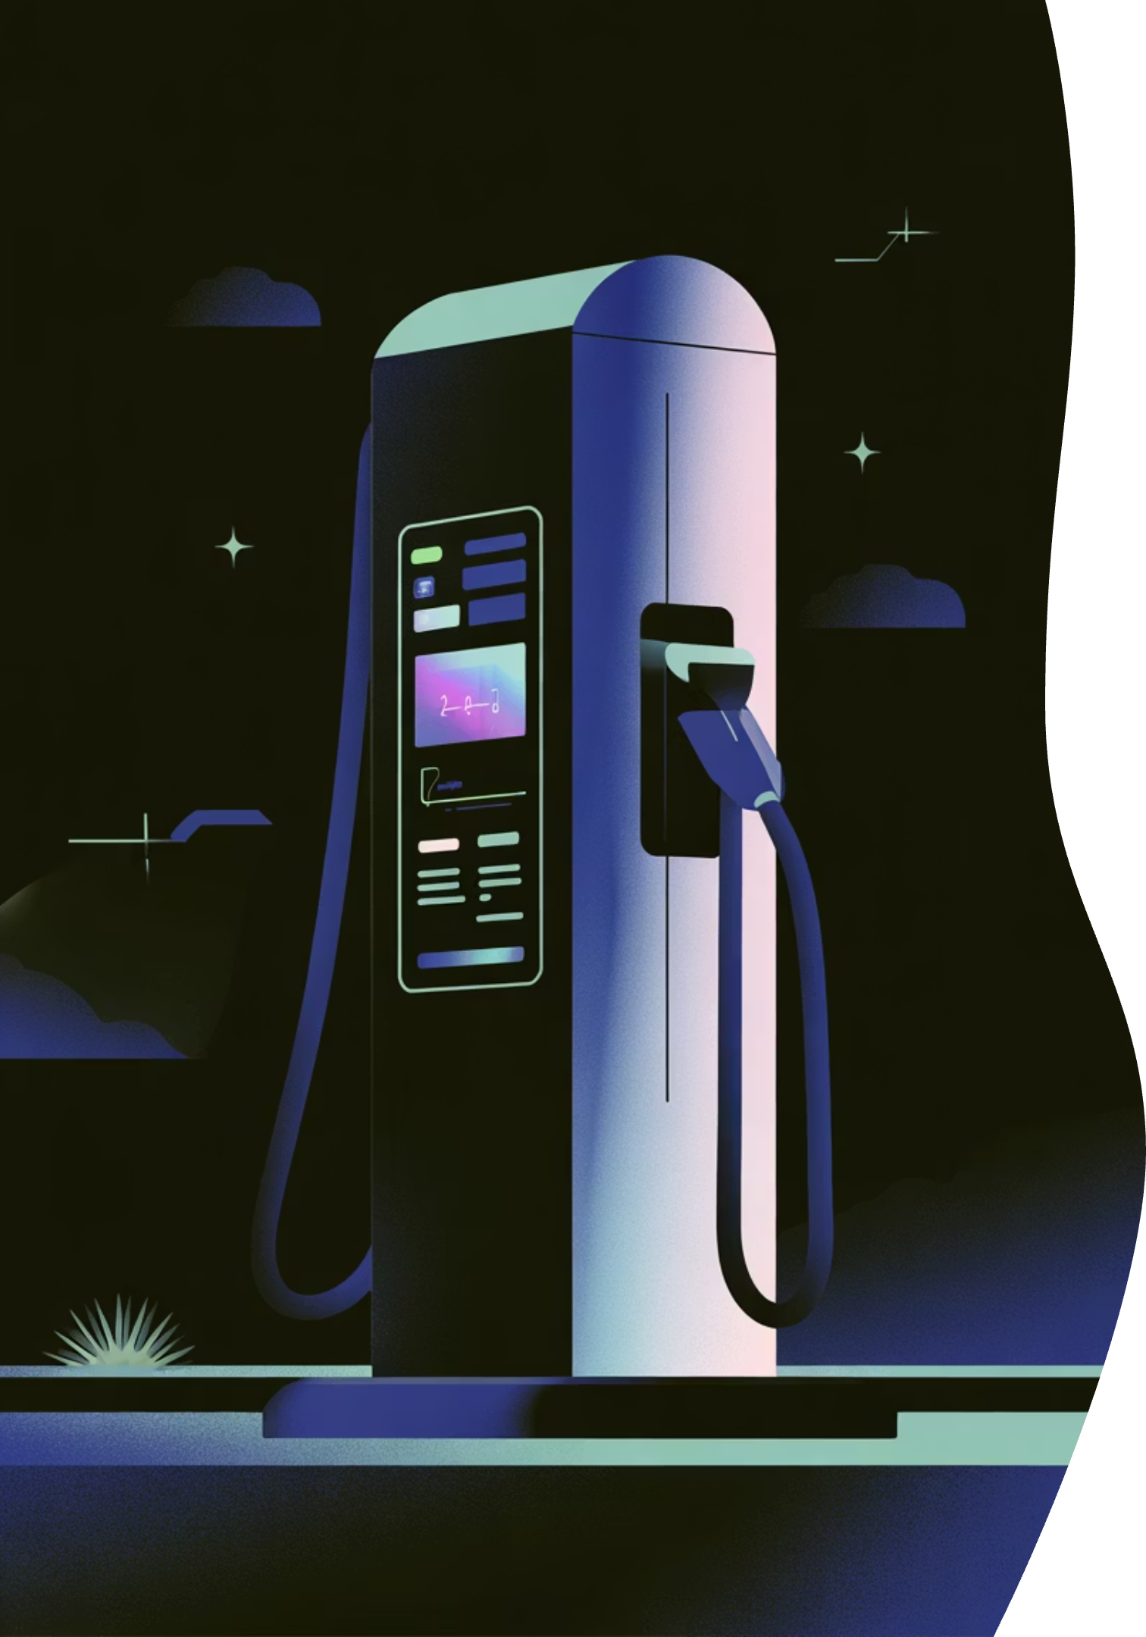

ElectricPe: Business Analysis & Recommendations
Transforming data into actionable strategies to accelerate growth, optimize operations, and enhance customer experience across the EV ecosystem.

Slide 2
Operations Health Check: Key Insights & Bottlenecks
Our analysis reveals strong lead conversion performance paired with critical service delivery and customer satisfaction challenges that require immediate attention.
Strong Conversion
Delivery Delays
Cold Lead Problem
72–76% lead conversion across all stores demonstrates excellent top-funnel performance
3.6 days average TAT with Mumbai showing higher delays indicates operational inefficiency
50% of leads marked as 'Cold' reveals large drop-offs after initial contact
Critical Customer Satisfaction Gap
NPS Crisis
Hidden Drop-offs
Overall Net Promoter Score sits at –66%, indicating severe customer dissatisfaction that threatens brand reputation and repeat business.
While cancellation rate shows 0%, the high "Cold" status reveals customers are dropping off before booking — meaning we're losing opportunities without proper tracking.
70%+ of ratings fall between 0–4
Only 10% promoters vs 76% detractors
Cancellations logged as "Other/Changed Mind"
Service follow-ups inconsistently recorded
No structured root-cause analysis
Missing follow-up data for many customers

Slide 3

Action Plan: Turning Insights Into Results
Strategic interventions across five focus areas will drive measurable improvements in conversion, delivery speed, and customer satisfaction.
Activate Cold Leads
Deploy automated follow-up workflow using SMS, calls, and WhatsApp to re-engage dormant leads
Impact: +10–15% conversion increase
Standardize Delivery
Implement store-specific SLAs with real-time tracking dashboards to eliminate delivery inconsistencies
Impact: Reduce TAT from 3.6 to <3 days
Enforce Follow-ups
Require mandatory service follow-up entry within 48 hours post-delivery for every customer
Impact: Higher trust and repeat purchase rates
Track Cancellations
Replace free-text cancellation reasons with structured dropdown menu for data-driven insights
Impact: Identify root causes and reduce drop-offs
Close the Loop
Launch post-delivery feedback system with dedicated instant resolution team for concerns
Impact: Improve NPS from –66% to ≥ –30% within one quarter
Expected Business Outcomes
1
2
3
Conversion Lift
Days TAT
NPS Improvement
Better funnel efficiency through cold lead nurturing
Faster delivery through standardized processes
From –66% to ≥ –30% in 90 days

